Slide 1
BigID CSV report
Oswaldo Cruz
Miguel Ojeda

Slide 2
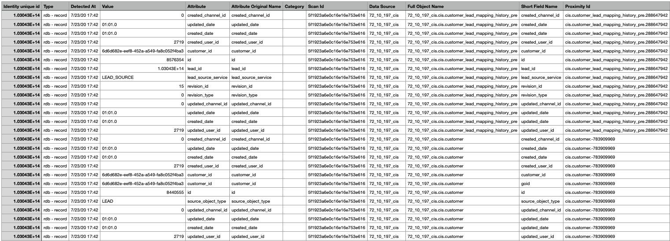
Original Report

Slide 3

Problem Statement
The original BigID report tends to be pretty large and not very user-friendly because of the way that it displays all the information during a scan phase.
For every attribute (column) identified as a possible PII in a record data source, the tool generates a new row in the report with all the related (and sometimes not needed) information.
Since some attributes from the created report most of the times are not needed, it is possible to modify this report in order to generate a new one with only meaningful information.

Slide 4
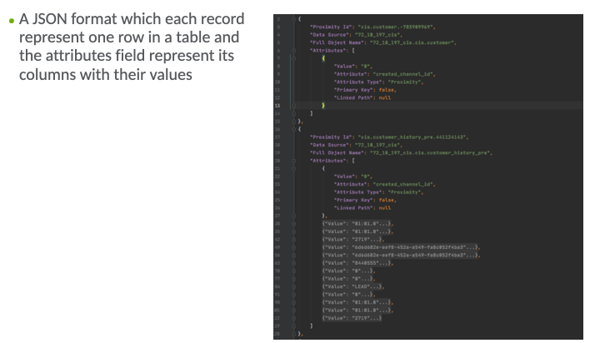
Option 1

Slide 5
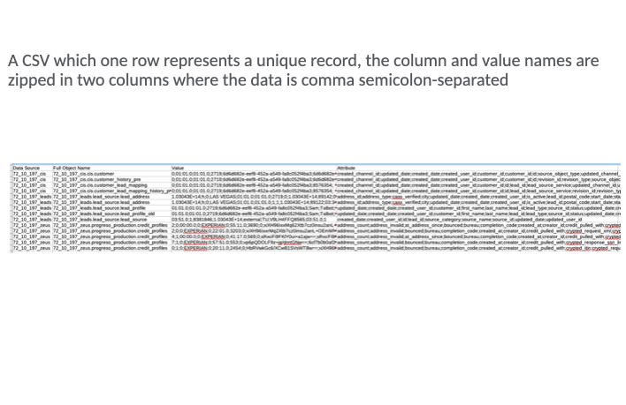
Option 2

Slide 6
Option 3
Value and Attribute column from original report
Proximity ID column as a record unique identifier

Slide 7
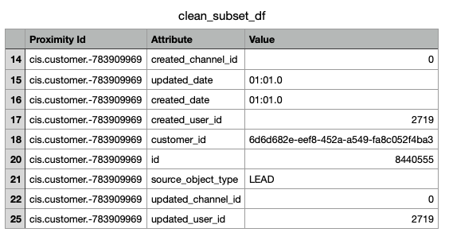

Option 3
Generate a new table for each object data source. This new table will have the Attribute and Value columns pivoted for every unique record.

